Slide 1
THREAT DETECTION ENGINEERING
Adversary Emulation, Detection SLO, Threat Intelligence, Automated Triage & Forensics
Stage 1 → Stage 6
Vedant Kale | Cloud Engineer Level 3+
Based on SG/PA/CLD-42-L3+ assignment • 19 August 2026
CONFIDENTIAL

Slide 2
STAGE 1
Repeatable Adversary Emulation Platform
CI-runnable emulation, ATT&CK technique coverage and coverage-delta evidence.
Screenshots in this section are arranged in the same practical order as the assignment stage.
SHREIK GLOBAL • THREAT DETECTION ENGINEERING
STAGE 1

Slide 3
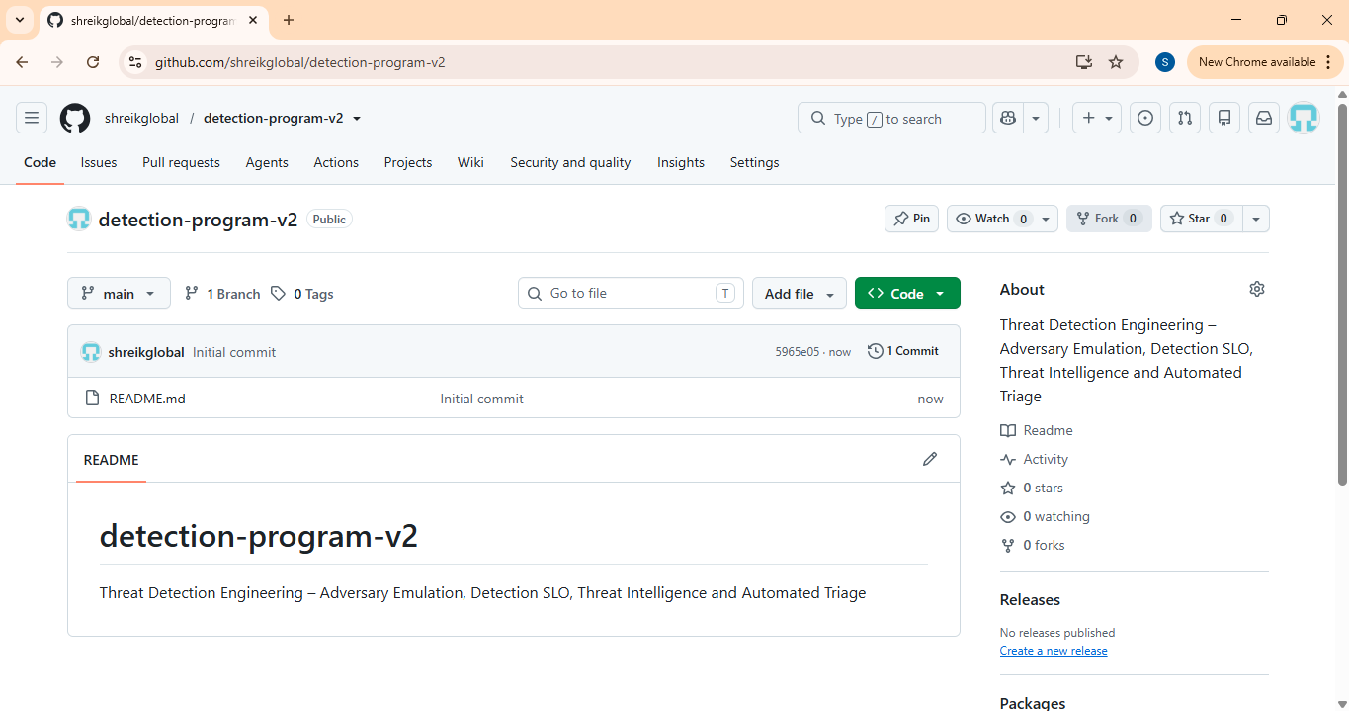
STAGE 1
Repeatable Adversary Emulation Platform
EVIDENCE 01/39
SIMPLE EXPLANATION
GitHub repository is created for the detection program. It gives one central place to keep the emulation, detections, documentation and supporting files.
SHREIK GLOBAL • THREAT DETECTION ENGINEERING
STAGE 1 • 1/16

Slide 4
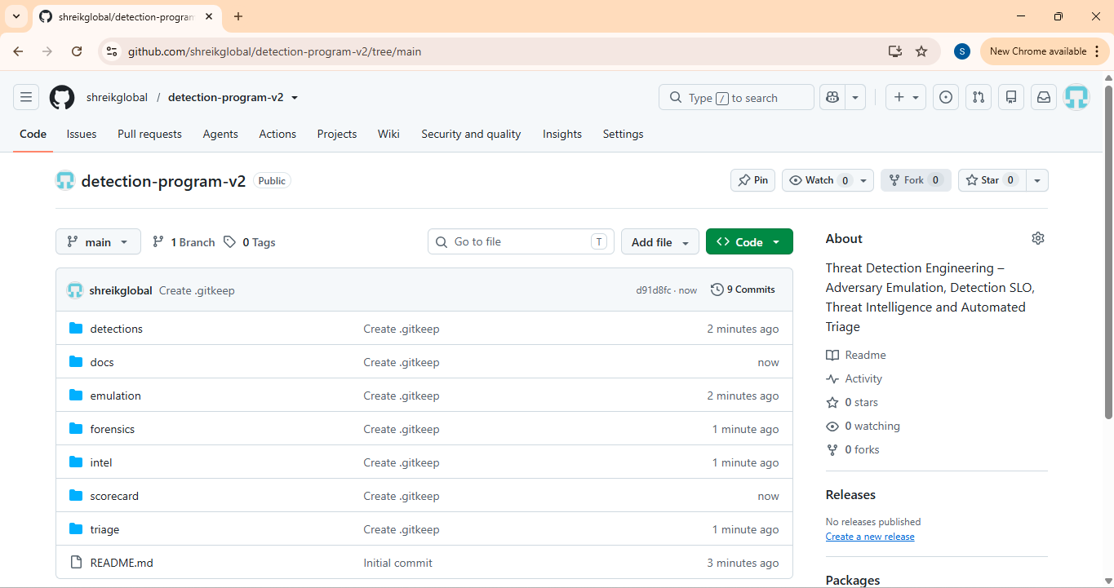
STAGE 1
Repeatable Adversary Emulation Platform
EVIDENCE 02/39
SIMPLE EXPLANATION
The repository structure is visible with folders for detections, docs, emulation, forensics, intel, scorecard and triage. This matches the planned project layout.
SHREIK GLOBAL • THREAT DETECTION ENGINEERING
STAGE 1 • 2/16

Slide 5
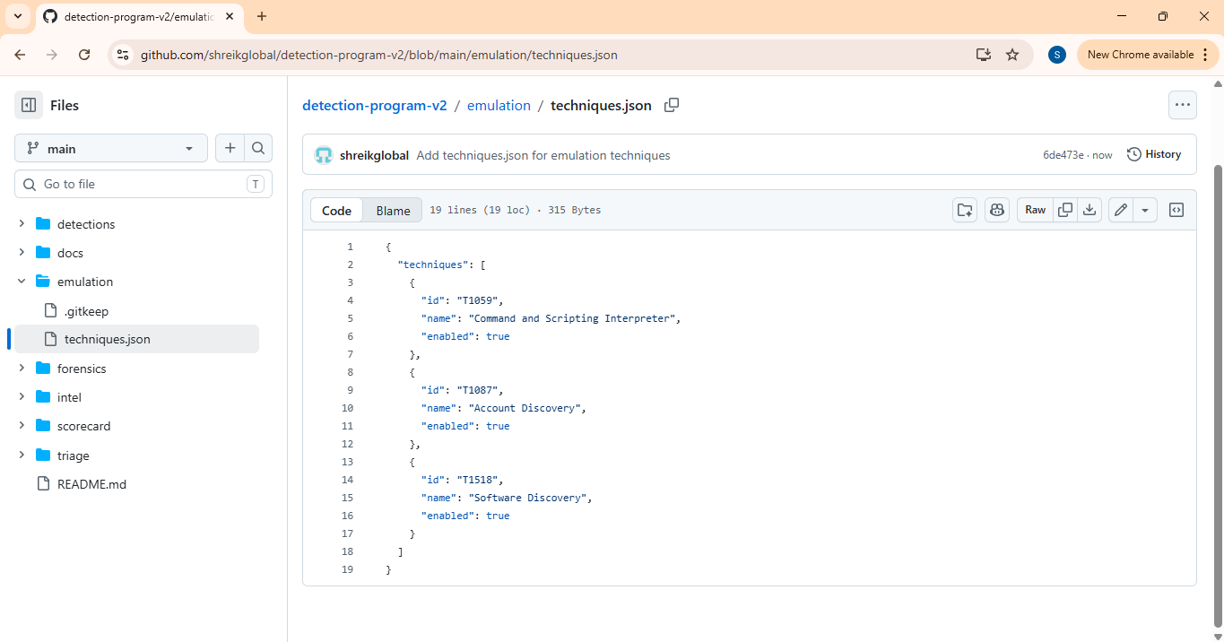
STAGE 1
Repeatable Adversary Emulation Platform
EVIDENCE 03/39
SIMPLE EXPLANATION
The ATT&CK technique list is stored in emulation/techniques.json. This file tells the runner which techniques should be tested.
SHREIK GLOBAL • THREAT DETECTION ENGINEERING
STAGE 1 • 3/16

Slide 6
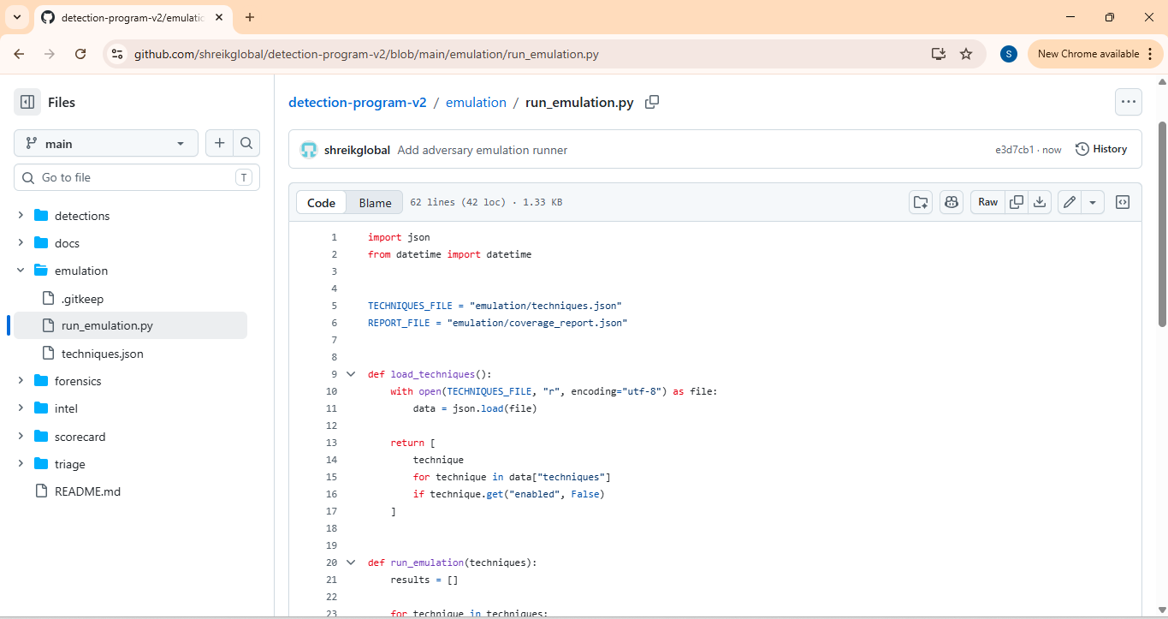
STAGE 1
Repeatable Adversary Emulation Platform
EVIDENCE 04/39
SIMPLE EXPLANATION
The emulation runner script is added. It reads the technique list and creates a coverage report after running the tests.
SHREIK GLOBAL • THREAT DETECTION ENGINEERING
STAGE 1 • 4/16

Slide 7
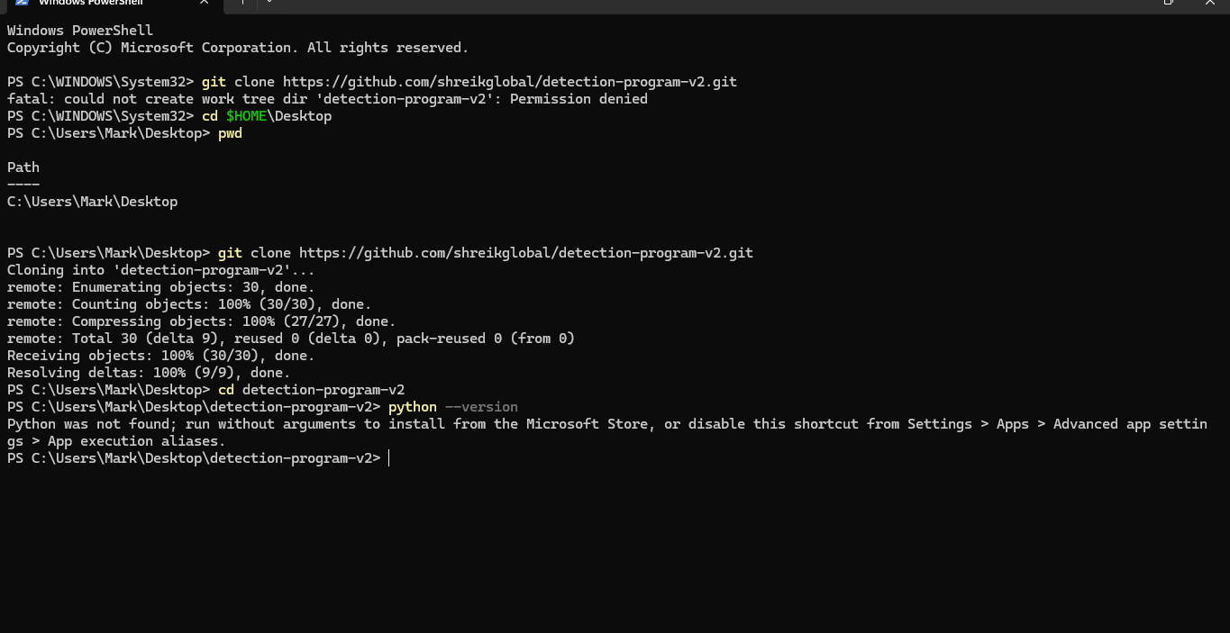
STAGE 1
Repeatable Adversary Emulation Platform
EVIDENCE 05/39
SIMPLE EXPLANATION
The repository is cloned locally so the emulation can be executed from the user's own test environment.
SHREIK GLOBAL • THREAT DETECTION ENGINEERING
STAGE 1 • 5/16

Slide 8
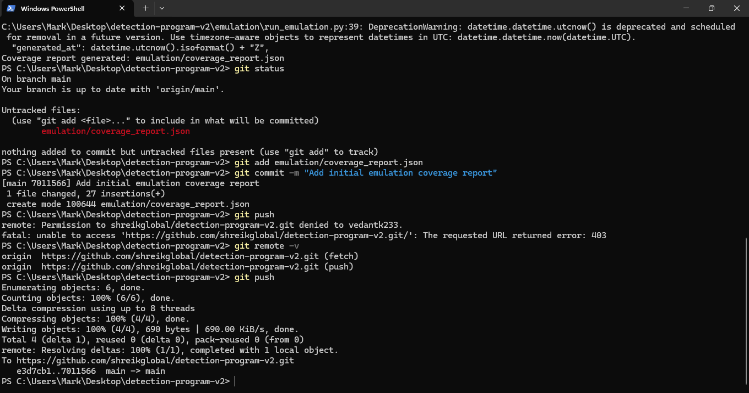
STAGE 1
Repeatable Adversary Emulation Platform
EVIDENCE 06/39
SIMPLE EXPLANATION
The first emulation run creates a coverage report. The screenshot shows the report being generated and committed to Git.
SHREIK GLOBAL • THREAT DETECTION ENGINEERING
STAGE 1 • 6/16

Slide 9
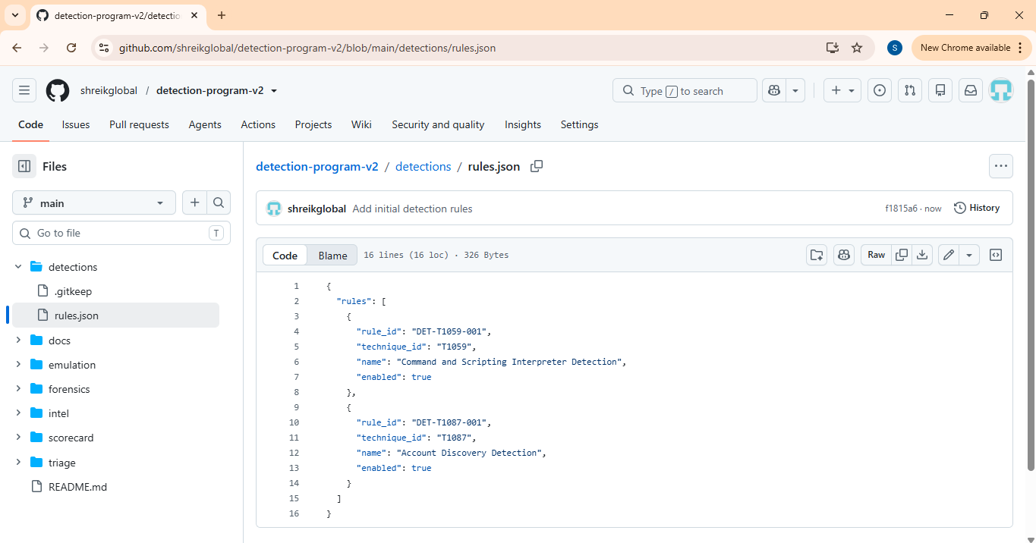
STAGE 1
Repeatable Adversary Emulation Platform
EVIDENCE 07/39
SIMPLE EXPLANATION
Initial detection rules are added in detections/rules.json. These rules connect ATT&CK techniques with detection logic.
SHREIK GLOBAL • THREAT DETECTION ENGINEERING
STAGE 1 • 7/16

Slide 10
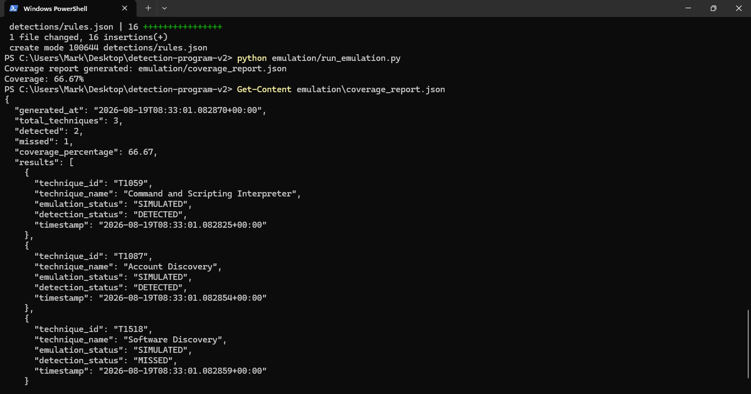
STAGE 1
Repeatable Adversary Emulation Platform
EVIDENCE 08/39
SIMPLE EXPLANATION
The first coverage result is generated successfully and shows 66.67% coverage. This proves the runner is connecting technique tests with detections.
SHREIK GLOBAL • THREAT DETECTION ENGINEERING
STAGE 1 • 8/16

Slide 11
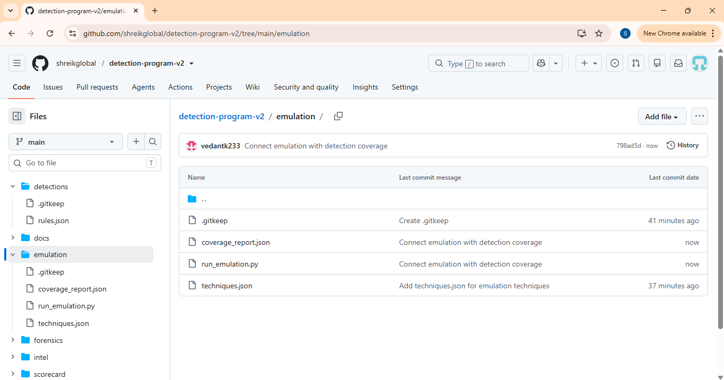
STAGE 1
Repeatable Adversary Emulation Platform
EVIDENCE 09/39
SIMPLE EXPLANATION
The emulation files are now stored in GitHub, including the coverage report and runner. This makes the work repeatable and version controlled.
SHREIK GLOBAL • THREAT DETECTION ENGINEERING
STAGE 1 • 9/16

Slide 12
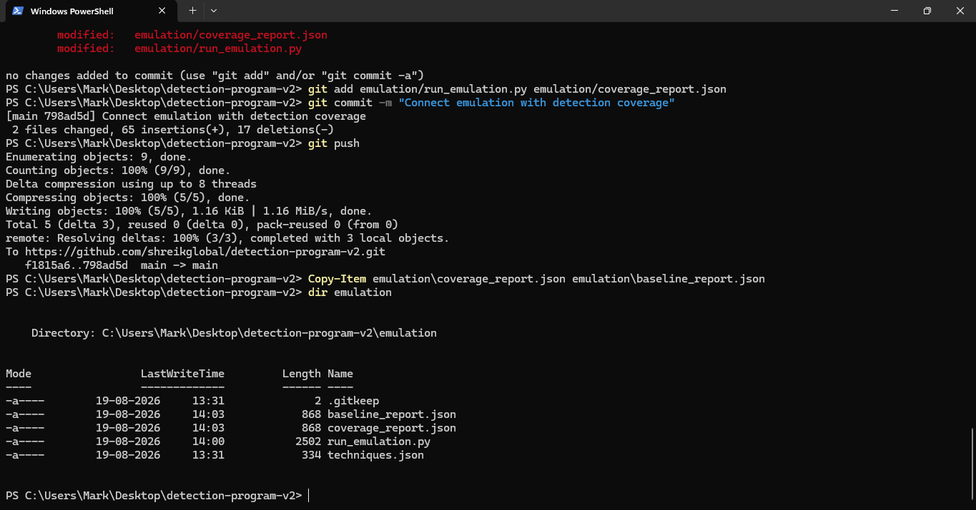
STAGE 1
Repeatable Adversary Emulation Platform
EVIDENCE 10/39
SIMPLE EXPLANATION
Updated emulation code and the coverage report are committed and pushed to GitHub. The local and remote repositories are synchronized.
SHREIK GLOBAL • THREAT DETECTION ENGINEERING
STAGE 1 • 10/16

Slide 13
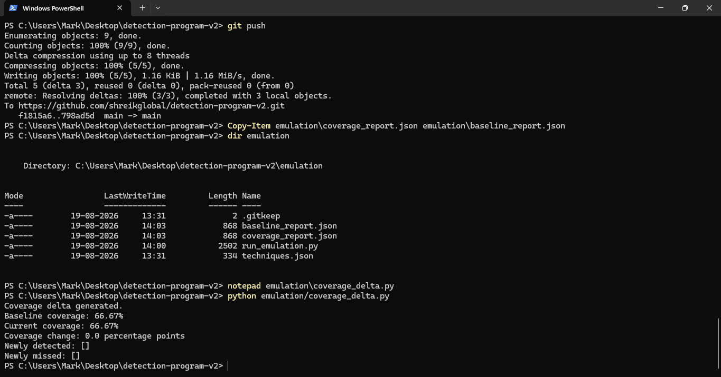
STAGE 1
Repeatable Adversary Emulation Platform
EVIDENCE 11/39
SIMPLE EXPLANATION
The latest push is confirmed. The new emulation changes are successfully available in the GitHub repository.
SHREIK GLOBAL • THREAT DETECTION ENGINEERING
STAGE 1 • 11/16

Slide 14
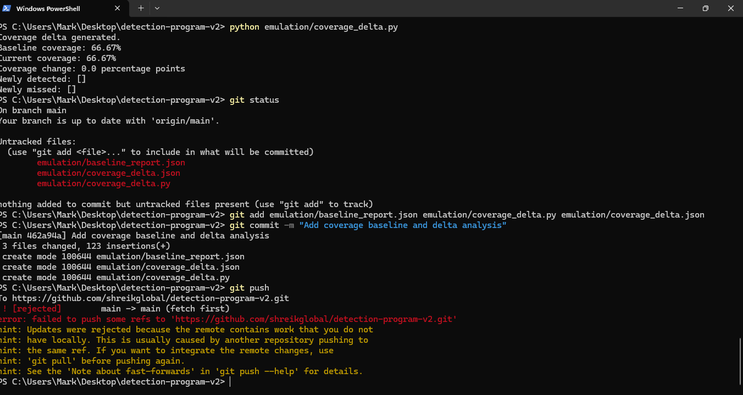
STAGE 1
Repeatable Adversary Emulation Platform
EVIDENCE 12/39
SIMPLE EXPLANATION
Coverage delta is generated by comparing the current run with the baseline. The result shows how coverage changed between runs.
SHREIK GLOBAL • THREAT DETECTION ENGINEERING
STAGE 1 • 12/16

Slide 15
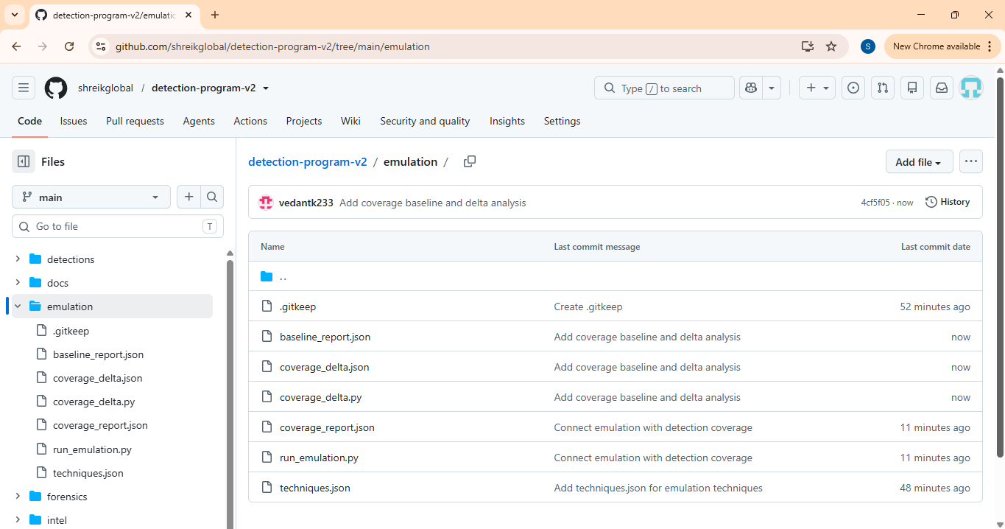
STAGE 1
Repeatable Adversary Emulation Platform
EVIDENCE 13/39
SIMPLE EXPLANATION
The baseline and delta reports are visible in GitHub. This provides a historical record of what was detected or missed.
SHREIK GLOBAL • THREAT DETECTION ENGINEERING
STAGE 1 • 13/16

Slide 16
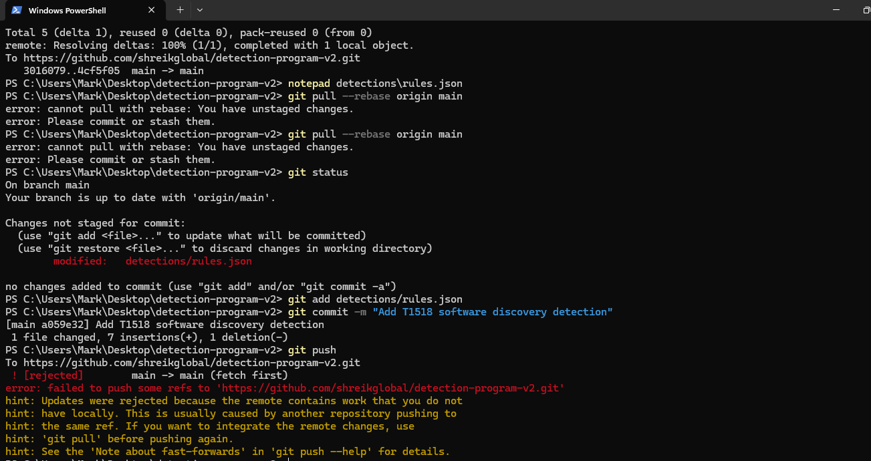
STAGE 1
Repeatable Adversary Emulation Platform
EVIDENCE 14/39
SIMPLE EXPLANATION
A new detection rule for T1518 software discovery is added. The screenshot also shows the normal Git workflow used to commit the change.
SHREIK GLOBAL • THREAT DETECTION ENGINEERING
STAGE 1 • 14/16

Slide 17
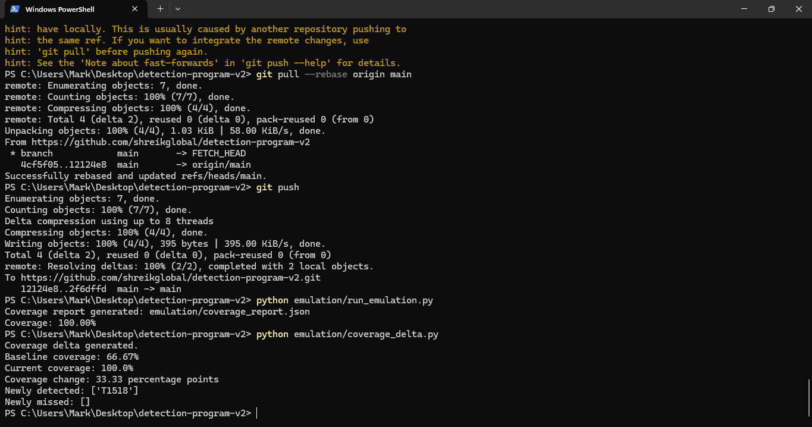
STAGE 1
Repeatable Adversary Emulation Platform
EVIDENCE 15/39
SIMPLE EXPLANATION
The local branch is rebased with the remote branch and the new changes are pushed successfully. This resolves the earlier push conflict and keeps the history clean.
SHREIK GLOBAL • THREAT DETECTION ENGINEERING
STAGE 1 • 15/16

Slide 18
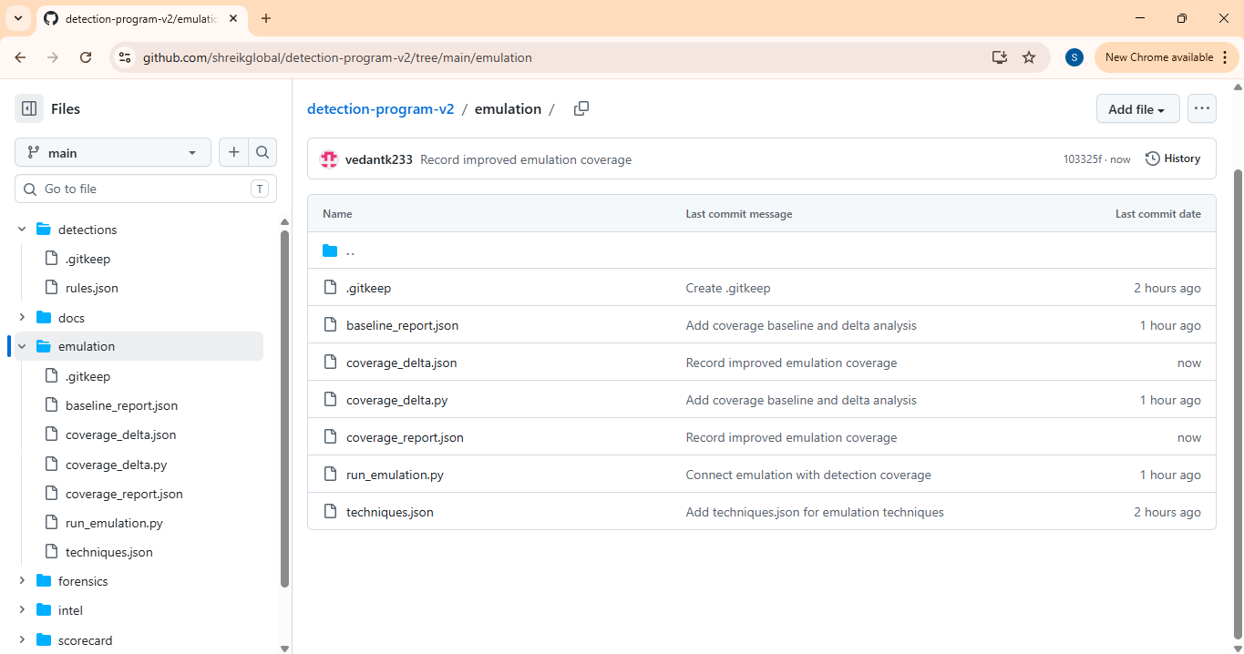
STAGE 1
Repeatable Adversary Emulation Platform
EVIDENCE 16/39
SIMPLE EXPLANATION
The improved emulation coverage is recorded in GitHub. The repository now contains the baseline, delta, coverage report and updated runner.
SHREIK GLOBAL • THREAT DETECTION ENGINEERING
STAGE 1 • 16/16

Slide 19
STAGE 2
Detection SLO with Noise Budget & Coverage Debt
Measure detection health and automatically enforce false-positive and coverage limits.
Screenshots in this section are arranged in the same practical order as the assignment stage.
SHREIK GLOBAL • THREAT DETECTION ENGINEERING
STAGE 2

Slide 20
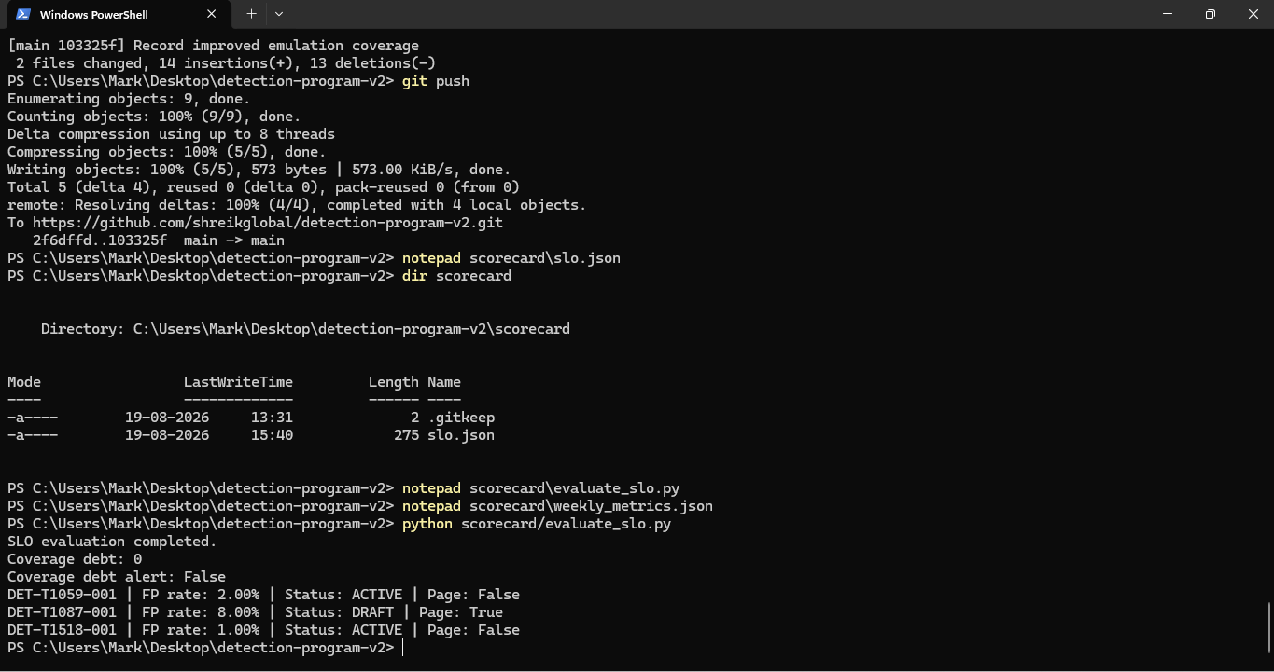
STAGE 2
Detection SLO with Noise Budget & Coverage Debt
EVIDENCE 17/39
SIMPLE EXPLANATION
The updated detection coverage is committed and pushed. Immediately after this, the SLO evaluation files are prepared.
SHREIK GLOBAL • THREAT DETECTION ENGINEERING
STAGE 2 • 1/6

Slide 21
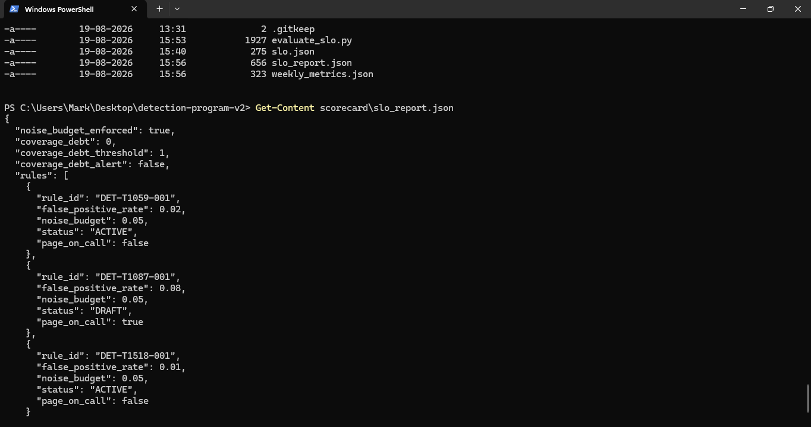
STAGE 2
Detection SLO with Noise Budget & Coverage Debt
EVIDENCE 18/39
SIMPLE EXPLANATION
The SLO evaluation script generates an SLO report. It checks noise budget, coverage debt and the status of each detection rule.
SHREIK GLOBAL • THREAT DETECTION ENGINEERING
STAGE 2 • 2/6

Slide 22
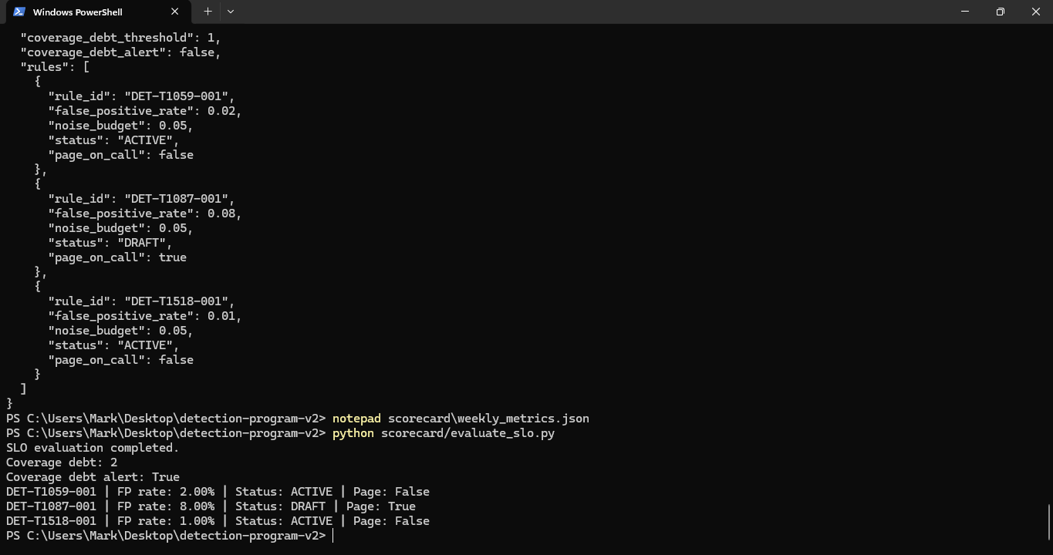
STAGE 2
Detection SLO with Noise Budget & Coverage Debt
EVIDENCE 19/39
SIMPLE EXPLANATION
The SLO report shows a rule exceeding the noise budget. That rule is moved to DRAFT and on-call paging is enabled, proving enforcement works.
SHREIK GLOBAL • THREAT DETECTION ENGINEERING
STAGE 2 • 3/6

Slide 23
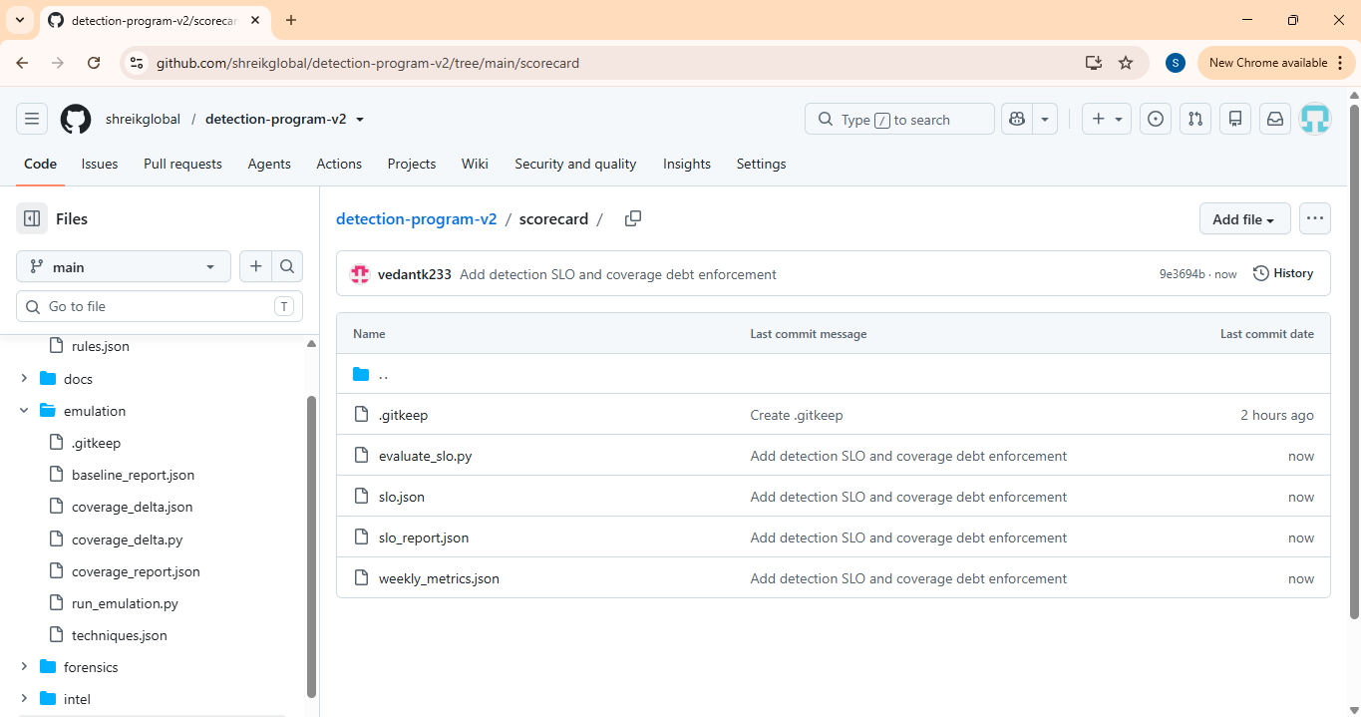
STAGE 2
Detection SLO with Noise Budget & Coverage Debt
EVIDENCE 20/39
SIMPLE EXPLANATION
The scorecard folder contains the SLO evaluator, baseline, coverage delta, SLO report and weekly metrics. This makes the SLO process repeatable.
SHREIK GLOBAL • THREAT DETECTION ENGINEERING
STAGE 2 • 4/6

Slide 24
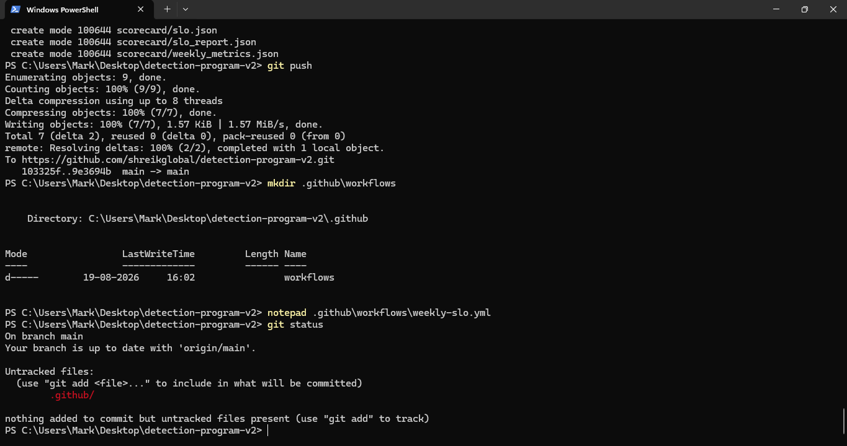
STAGE 2
Detection SLO with Noise Budget & Coverage Debt
EVIDENCE 21/39
SIMPLE EXPLANATION
The generated SLO files are committed and pushed to GitHub so the enforcement evidence is version controlled.
SHREIK GLOBAL • THREAT DETECTION ENGINEERING
STAGE 2 • 5/6

Slide 25
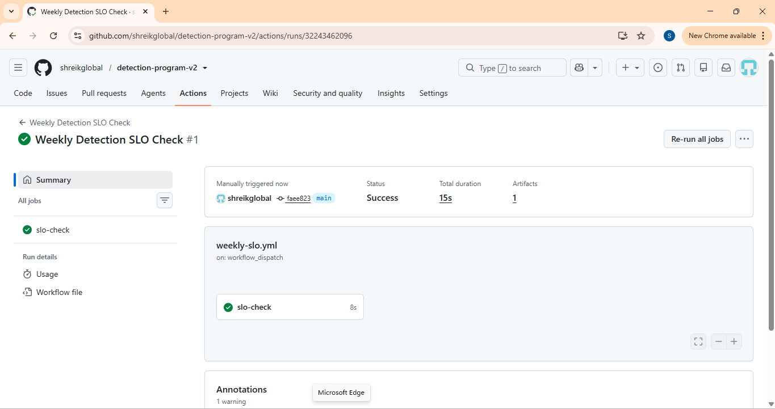
STAGE 2
Detection SLO with Noise Budget & Coverage Debt
EVIDENCE 22/39
SIMPLE EXPLANATION
GitHub Actions runs the Weekly Detection SLO Check and finishes with SUCCESS. This proves the SLO check can be enforced through CI.
SHREIK GLOBAL • THREAT DETECTION ENGINEERING
STAGE 2 • 6/6

Slide 26
STAGE 3
Live Threat Intelligence Enrichment
Automatically add adversary context, IOC confidence and enrichment-latency evidence.
Screenshots in this section are arranged in the same practical order as the assignment stage.
SHREIK GLOBAL • THREAT DETECTION ENGINEERING
STAGE 3

Slide 27
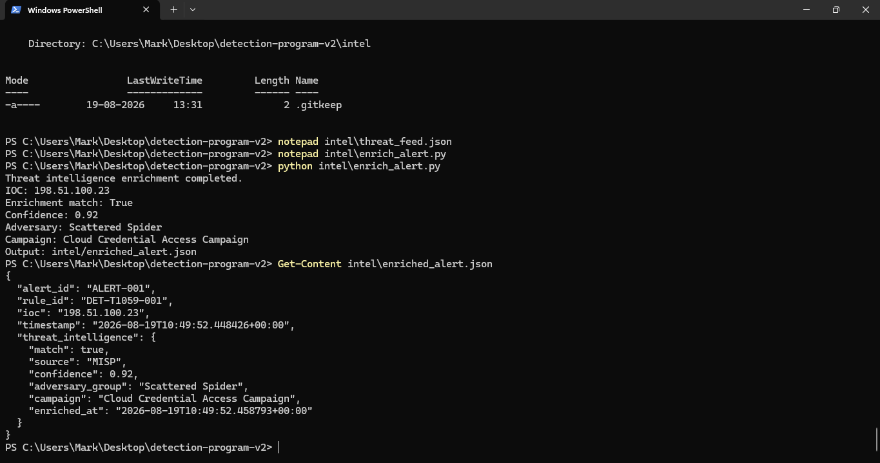
STAGE 3
Live Threat Intelligence Enrichment
EVIDENCE 23/39
SIMPLE EXPLANATION
The threat-intelligence feed and enrichment script are prepared. A sample IOC is checked and a matching threat-intelligence record is found with high confidence.
SHREIK GLOBAL • THREAT DETECTION ENGINEERING
STAGE 3 • 1/6

Slide 28
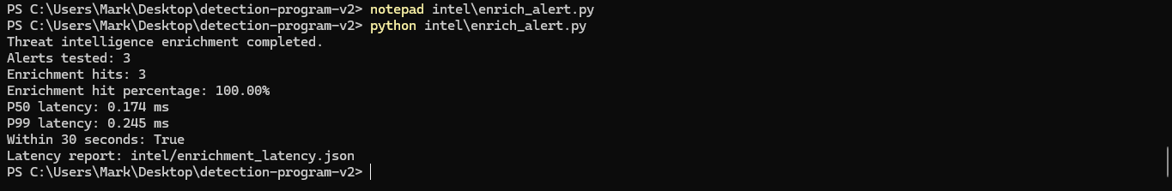
STAGE 3
Live Threat Intelligence Enrichment
EVIDENCE 24/39
SIMPLE EXPLANATION
Three alerts are tested. All three receive enrichment, giving a 100% enrichment hit rate, and the measured latency is within the required 30-second limit.
SHREIK GLOBAL • THREAT DETECTION ENGINEERING
STAGE 3 • 2/6

Slide 29
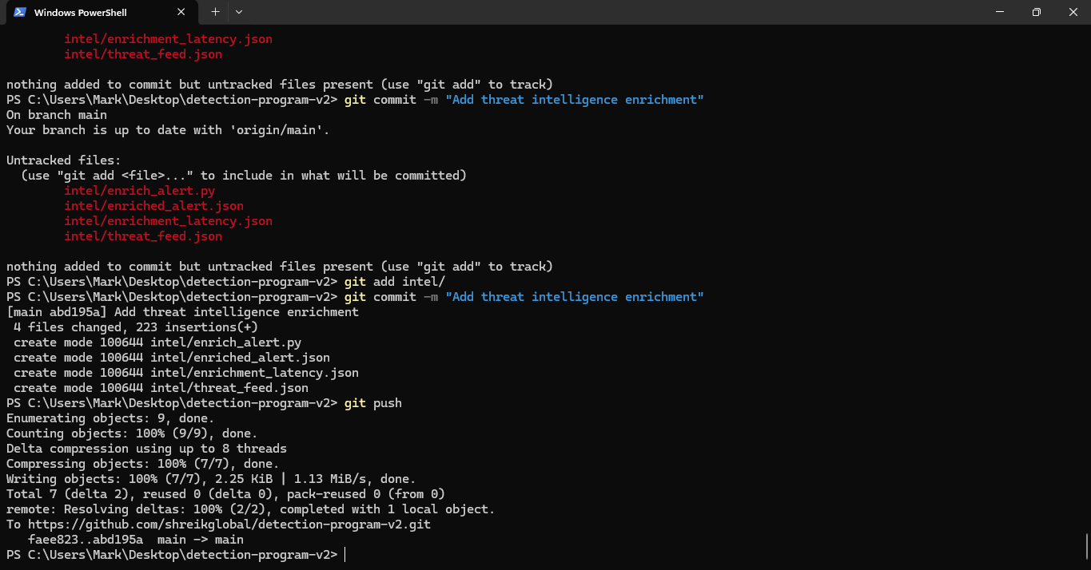
STAGE 3
Live Threat Intelligence Enrichment
EVIDENCE 25/39
SIMPLE EXPLANATION
The enrichment files are ready to be committed: feed data, enrichment code, enriched alerts and latency report. This packages the TI evidence for Git.
SHREIK GLOBAL • THREAT DETECTION ENGINEERING
STAGE 3 • 3/6

Slide 30
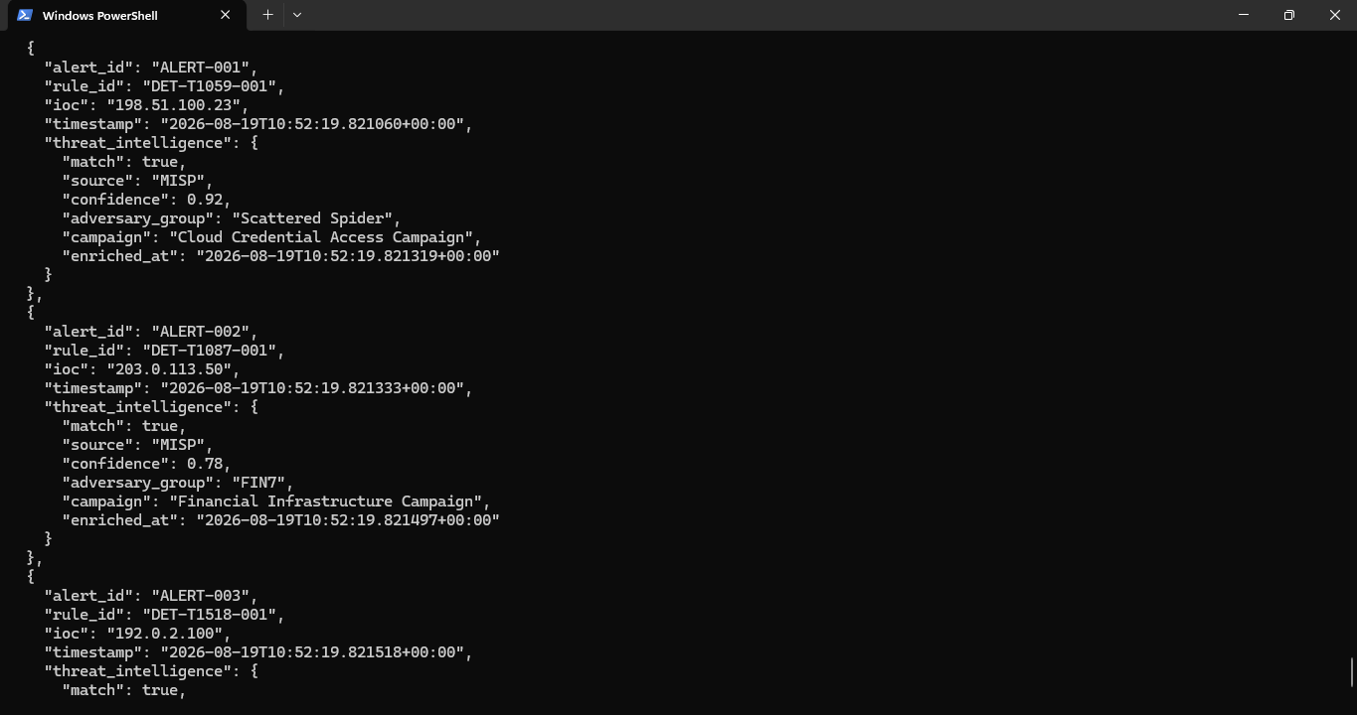
STAGE 3
Live Threat Intelligence Enrichment
EVIDENCE 26/39
SIMPLE EXPLANATION
The enriched alert output contains adversary and campaign context along with the detection rule. This turns a raw technical alert into useful threat context.
SHREIK GLOBAL • THREAT DETECTION ENGINEERING
STAGE 3 • 4/6

Slide 31
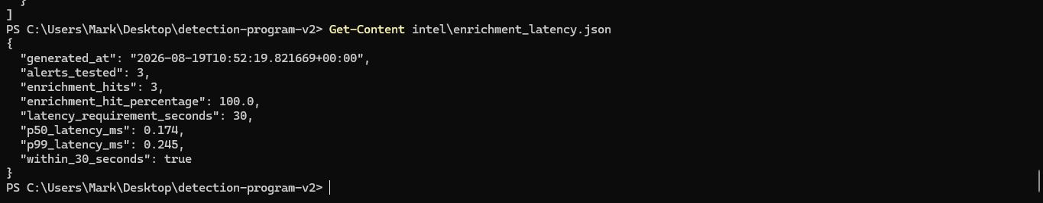
STAGE 3
Live Threat Intelligence Enrichment
EVIDENCE 27/39
SIMPLE EXPLANATION
The latency report confirms 100% enrichment and that the measured processing time is within the 30-second requirement.
SHREIK GLOBAL • THREAT DETECTION ENGINEERING
STAGE 3 • 5/6

Slide 32
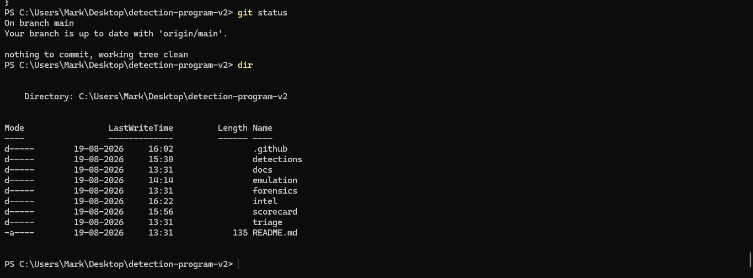
STAGE 3
Live Threat Intelligence Enrichment
EVIDENCE 28/39
SIMPLE EXPLANATION
The repository status is clean after the enrichment work, showing the threat-intelligence changes have been integrated into the project.
SHREIK GLOBAL • THREAT DETECTION ENGINEERING
STAGE 3 • 6/6

Slide 33
STAGE 4
Automated Triage with Confidence Scoring
Use confidence thresholds to escalate, review or suppress alerts automatically.
Screenshots in this section are arranged in the same practical order as the assignment stage.
SHREIK GLOBAL • THREAT DETECTION ENGINEERING
STAGE 4

Slide 34
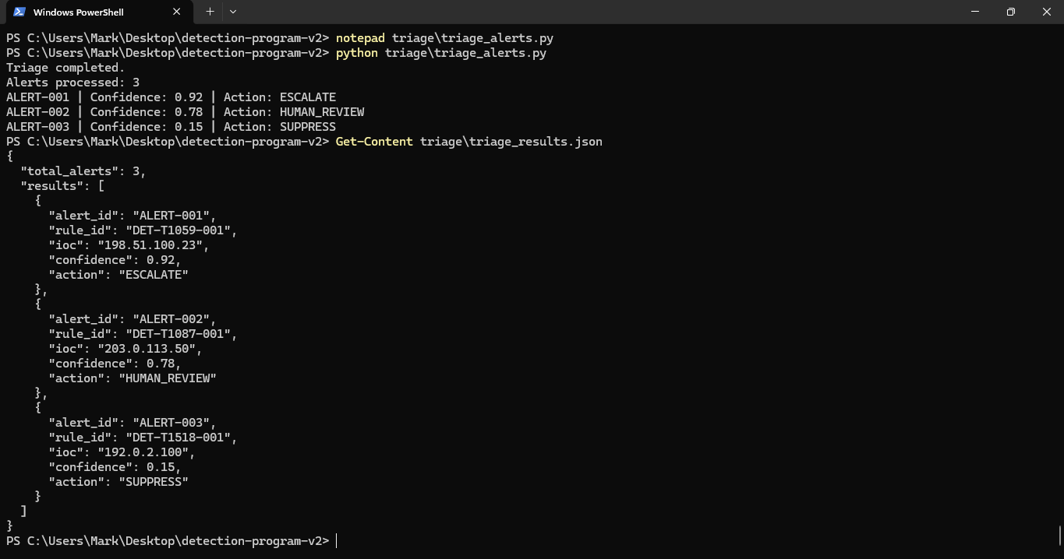
STAGE 4
Automated Triage with Confidence Scoring
EVIDENCE 29/39
SIMPLE EXPLANATION
The triage script processes three alerts and assigns confidence scores. The actions shown are ESCALATE, HUMAN_REVIEW and SUPPRESS.
SHREIK GLOBAL • THREAT DETECTION ENGINEERING
STAGE 4 • 1/5

Slide 35
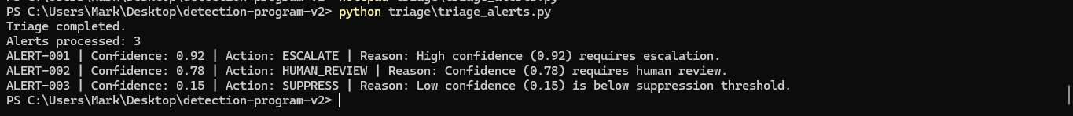
STAGE 4
Automated Triage with Confidence Scoring
EVIDENCE 30/39
SIMPLE EXPLANATION
The same three decisions are explained with simple reasons: high confidence is escalated, medium confidence goes to a human, and low confidence is suppressed.
SHREIK GLOBAL • THREAT DETECTION ENGINEERING
STAGE 4 • 2/5

Slide 36
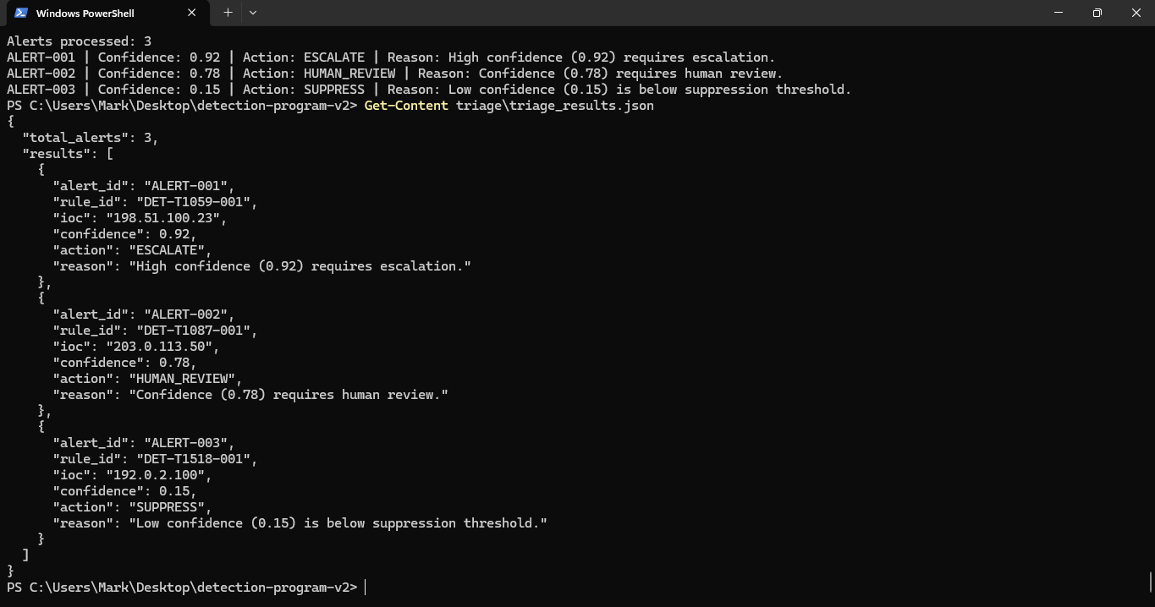
STAGE 4
Automated Triage with Confidence Scoring
EVIDENCE 31/39
SIMPLE EXPLANATION
The triage result JSON is displayed. It stores the alert, detection rule, confidence and final action in a machine-readable format.
SHREIK GLOBAL • THREAT DETECTION ENGINEERING
STAGE 4 • 3/5

Slide 37
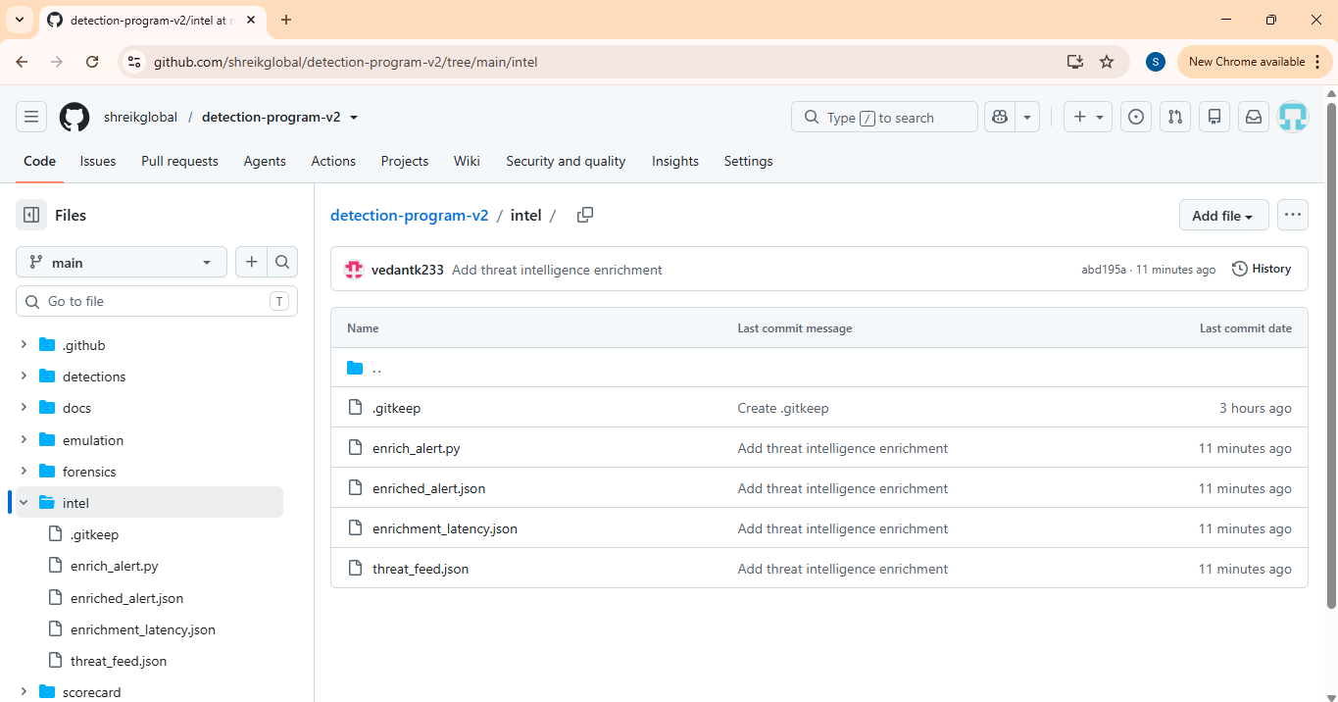
STAGE 4
Automated Triage with Confidence Scoring
EVIDENCE 32/39
SIMPLE EXPLANATION
The triage work is committed in GitHub. The repository now contains the automated triage script, rules and results.
SHREIK GLOBAL • THREAT DETECTION ENGINEERING
STAGE 4 • 4/5

Slide 38
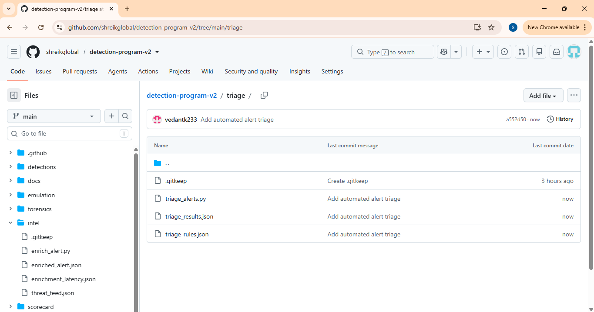
STAGE 4
Automated Triage with Confidence Scoring
EVIDENCE 33/39
SIMPLE EXPLANATION
The GitHub repository shows the triage implementation and result files together with the rest of the detection program.
SHREIK GLOBAL • THREAT DETECTION ENGINEERING
STAGE 4 • 5/5

Slide 39
STAGE 5
Forensic Chain of Custody
Collect artifacts, verify hashes and prove tamper detection.
Screenshots in this section are arranged in the same practical order as the assignment stage.
SHREIK GLOBAL • THREAT DETECTION ENGINEERING
STAGE 5

Slide 40
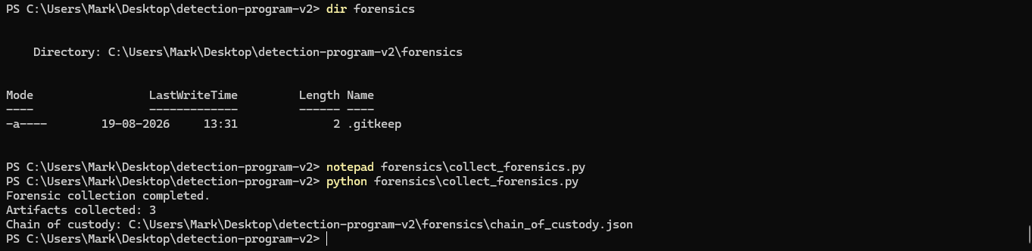
STAGE 5
Forensic Chain of Custody
EVIDENCE 34/39
SIMPLE EXPLANATION
Forensic collection is executed and three artifacts are collected. A chain-of-custody JSON file is generated to track the evidence.
SHREIK GLOBAL • THREAT DETECTION ENGINEERING
STAGE 5 • 1/4

Slide 41
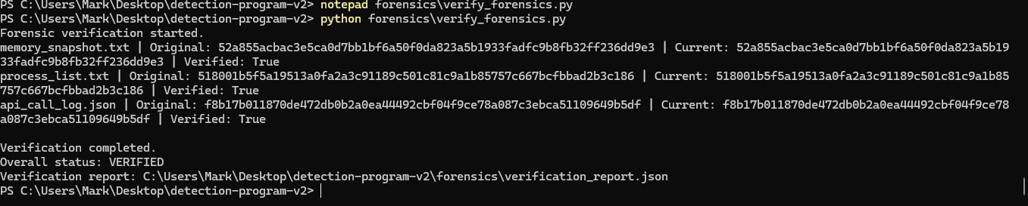
STAGE 5
Forensic Chain of Custody
EVIDENCE 35/39
SIMPLE EXPLANATION
Each artifact is re-hashed and compared with its original hash. All three checks return Verified: True, so the evidence is intact.
SHREIK GLOBAL • THREAT DETECTION ENGINEERING
STAGE 5 • 2/4

Slide 42
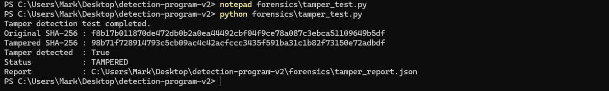
STAGE 5
Forensic Chain of Custody
EVIDENCE 36/39
SIMPLE EXPLANATION
A deliberate tamper test changes an artifact. The original and tampered SHA-256 values differ, so the system correctly reports TAMPERED.
SHREIK GLOBAL • THREAT DETECTION ENGINEERING
STAGE 5 • 3/4

Slide 43
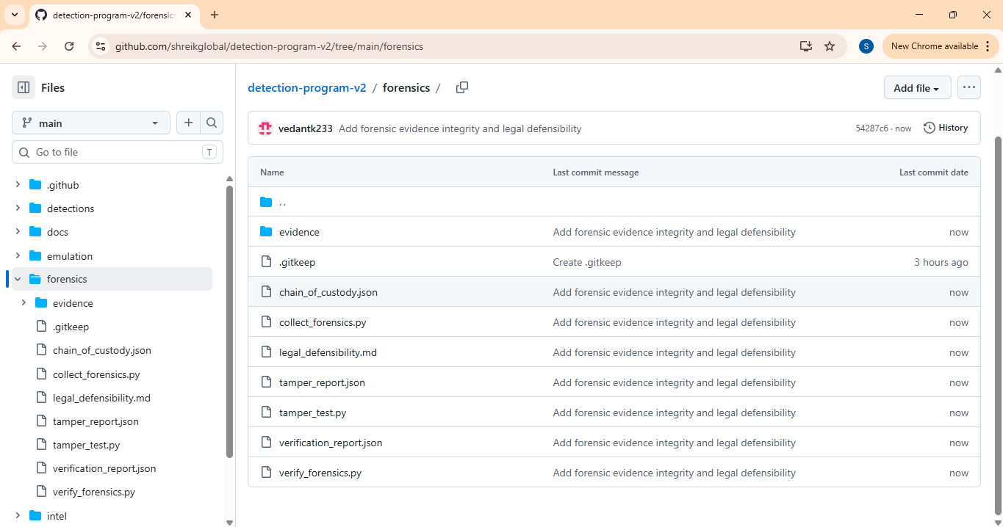
STAGE 5
Forensic Chain of Custody
EVIDENCE 37/39
SIMPLE EXPLANATION
The forensic evidence, chain-of-custody record, verification report and legal-defensibility document are stored in GitHub. This completes the forensic evidence package.
SHREIK GLOBAL • THREAT DETECTION ENGINEERING
STAGE 5 • 4/4

Slide 44
STAGE 6
Detection Program Health Scorecard
Generate the final scorecard from coverage, enrichment, triage and forensic results.
Screenshots in this section are arranged in the same practical order as the assignment stage.
SHREIK GLOBAL • THREAT DETECTION ENGINEERING
STAGE 6

Slide 45
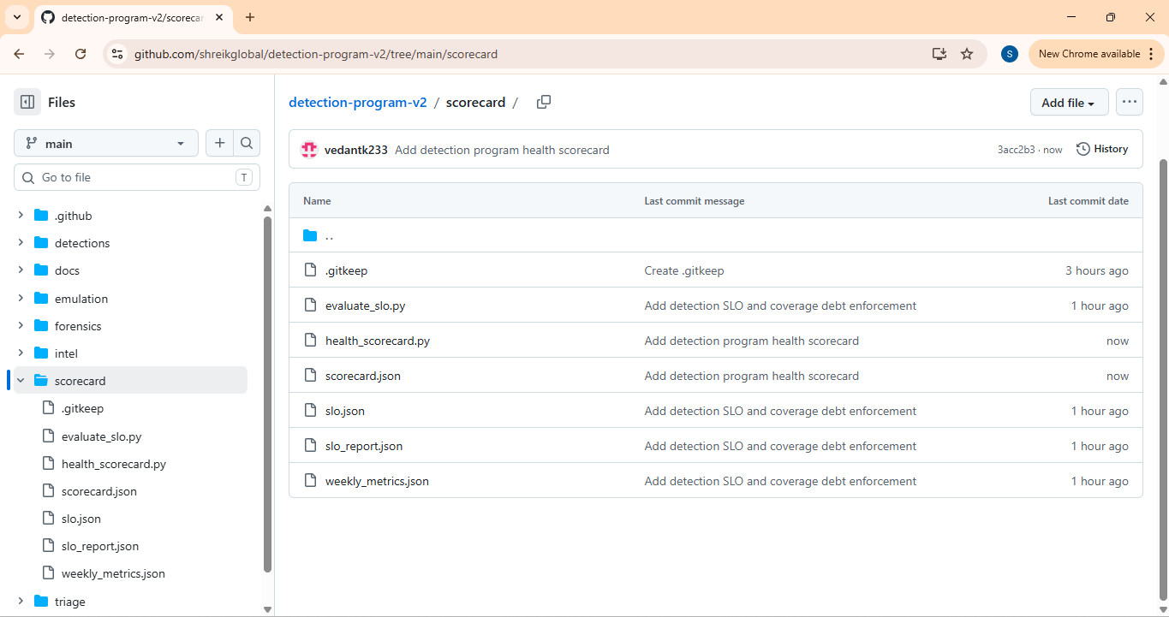
STAGE 6
Detection Program Health Scorecard
EVIDENCE 38/39
SIMPLE EXPLANATION
The final scorecard area in GitHub contains the health-scorecard generator and supporting program metrics. It combines the results of the earlier stages.
SHREIK GLOBAL • THREAT DETECTION ENGINEERING
STAGE 6 • 1/2

Slide 46
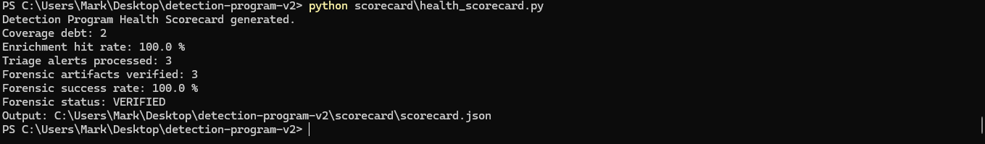
STAGE 6
Detection Program Health Scorecard
EVIDENCE 39/39
SIMPLE EXPLANATION
The health scorecard is generated successfully. It reports coverage debt, 100% enrichment hit rate, 3 triage alerts processed and 3 forensic artifacts verified with a 100% forensic success rate.
SHREIK GLOBAL • THREAT DETECTION ENGINEERING
STAGE 6 • 2/2

Slide 47
Final Evidence Summary
All 39 screenshots are now grouped according to Stage 1 → Stage 6.
Stage 1
16 screenshots
Emulation + ATT&CK coverage + baseline/delta
Stage 2
6 screenshots
SLO + noise budget + coverage debt + CI
Stage 3
6 screenshots
Threat-intelligence enrichment + latency
Stage 4
5 screenshots
Confidence-based automated triage
Stage 5
4 screenshots
Chain of custody + hash verification + tamper test
Stage 6
2 screenshots
Health scorecard generation + final metrics
This version follows the assignment stage sequence instead of mixing the screenshots.
SHREIK GLOBAL • THREAT DETECTION ENGINEERING
FINAL

